Slide 1
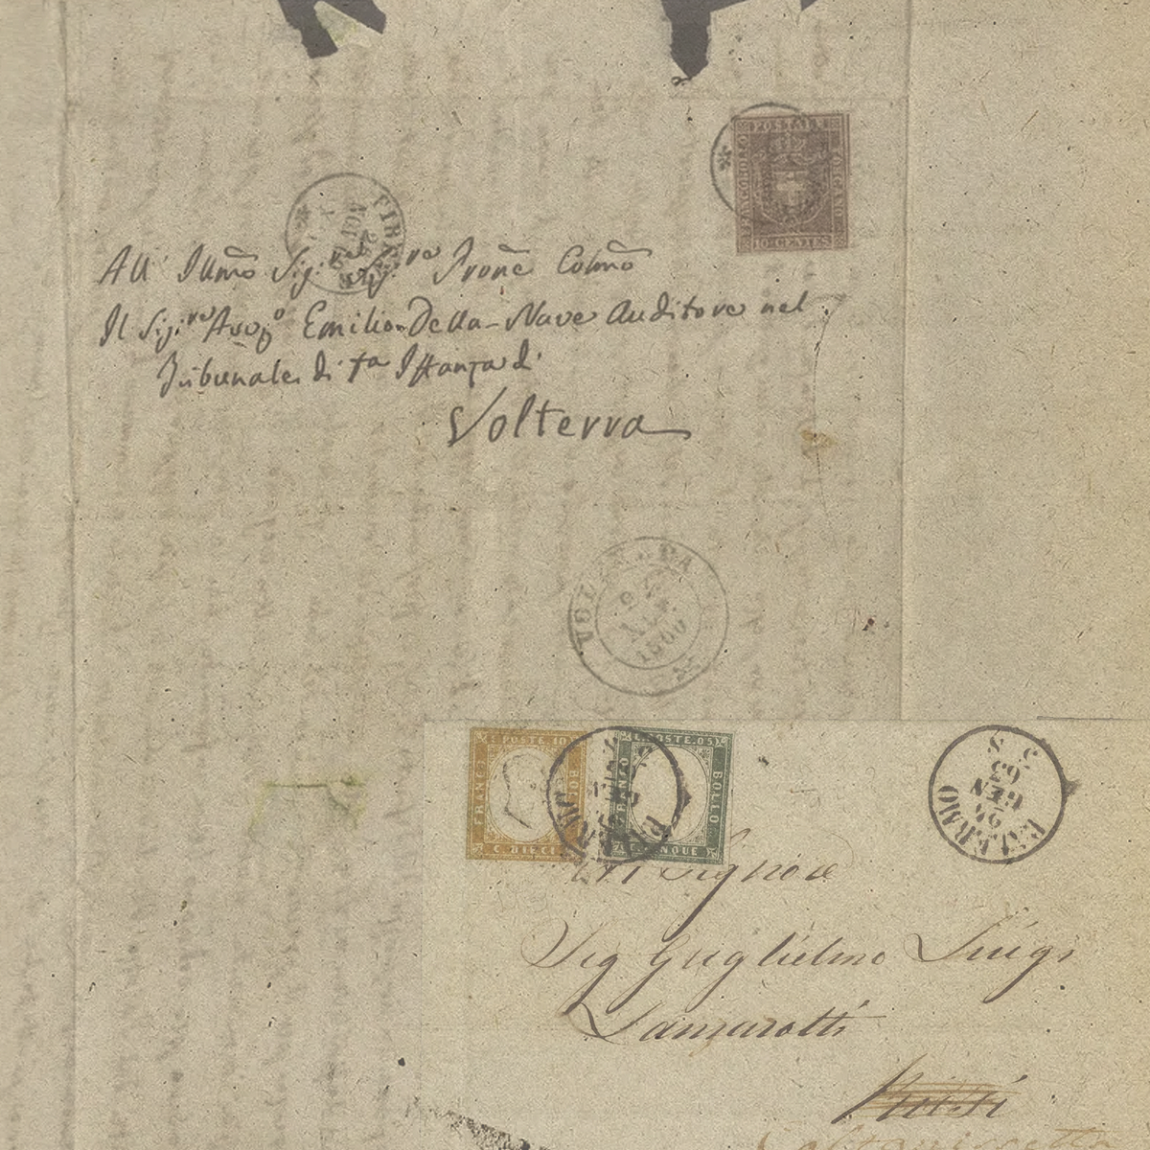
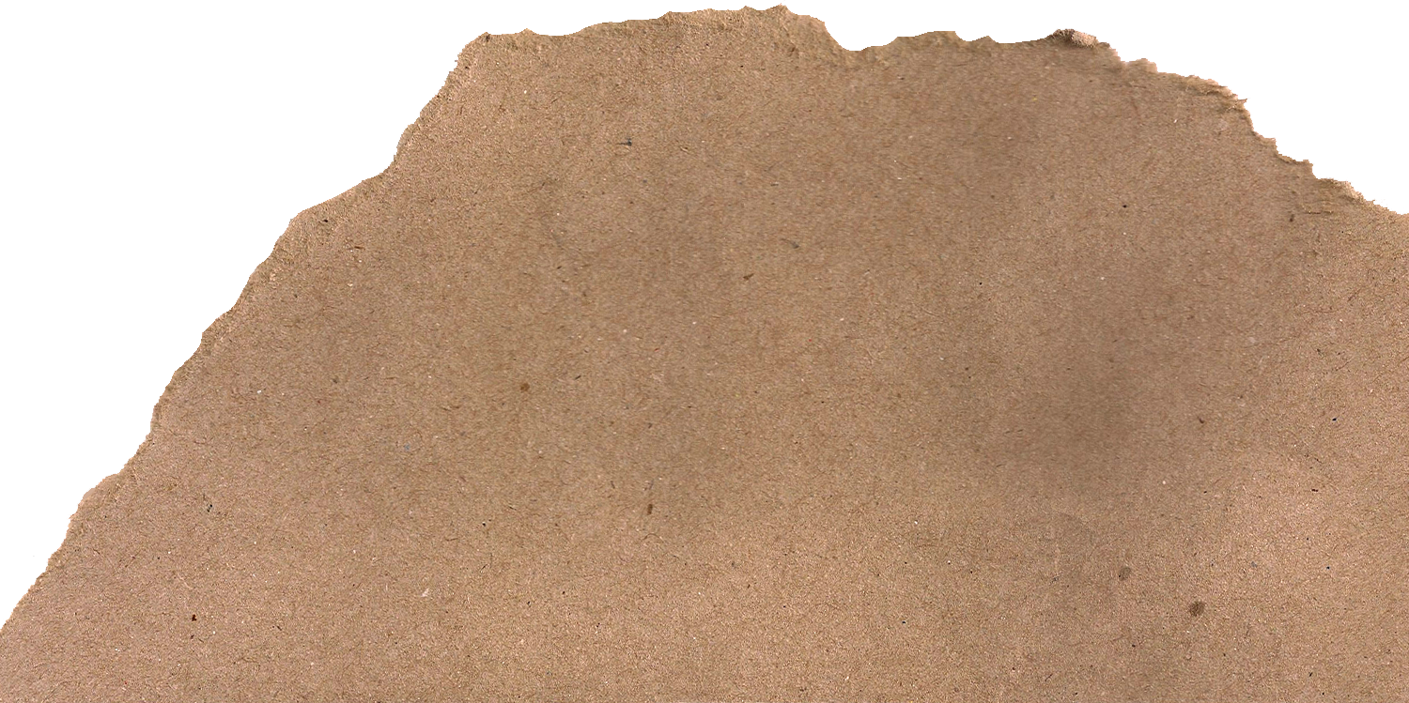






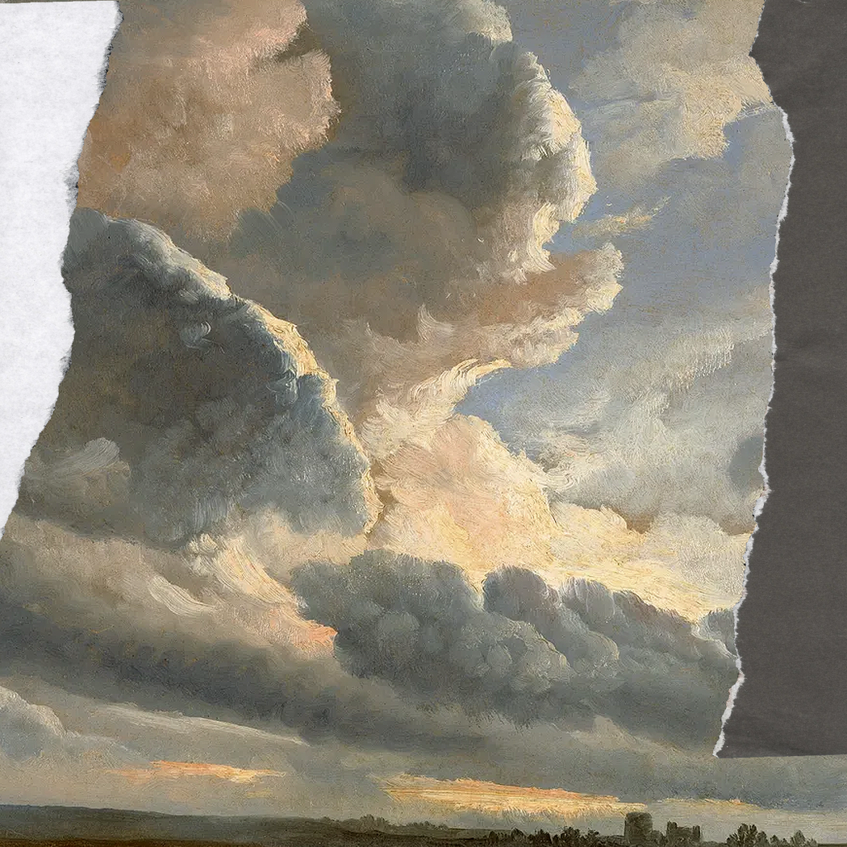

How Space-Tech is Uncovering our Past
Machine Learning, AI, and Bolivia at the FLMNH
Raul Rojas
Anthropology & Computer Science
Mentor: Dr. Nicolas Gauthier

Slide 2


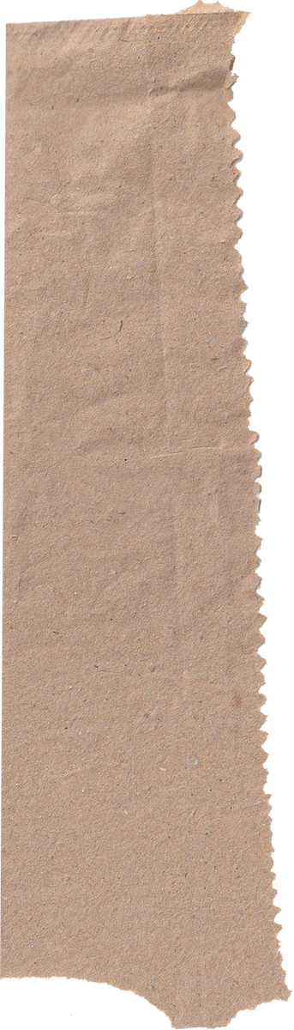



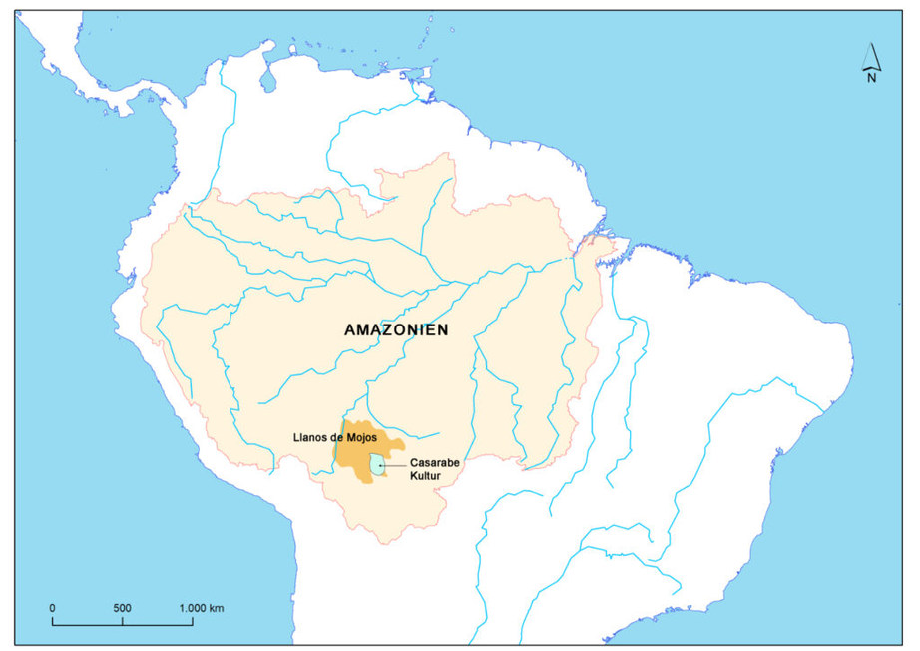

Background
Massive cities like El Dorado reported since first voyage on the Amazon River
Relegated to tall tales
Today, recent advances in computing offer a new perspective

Slide 3



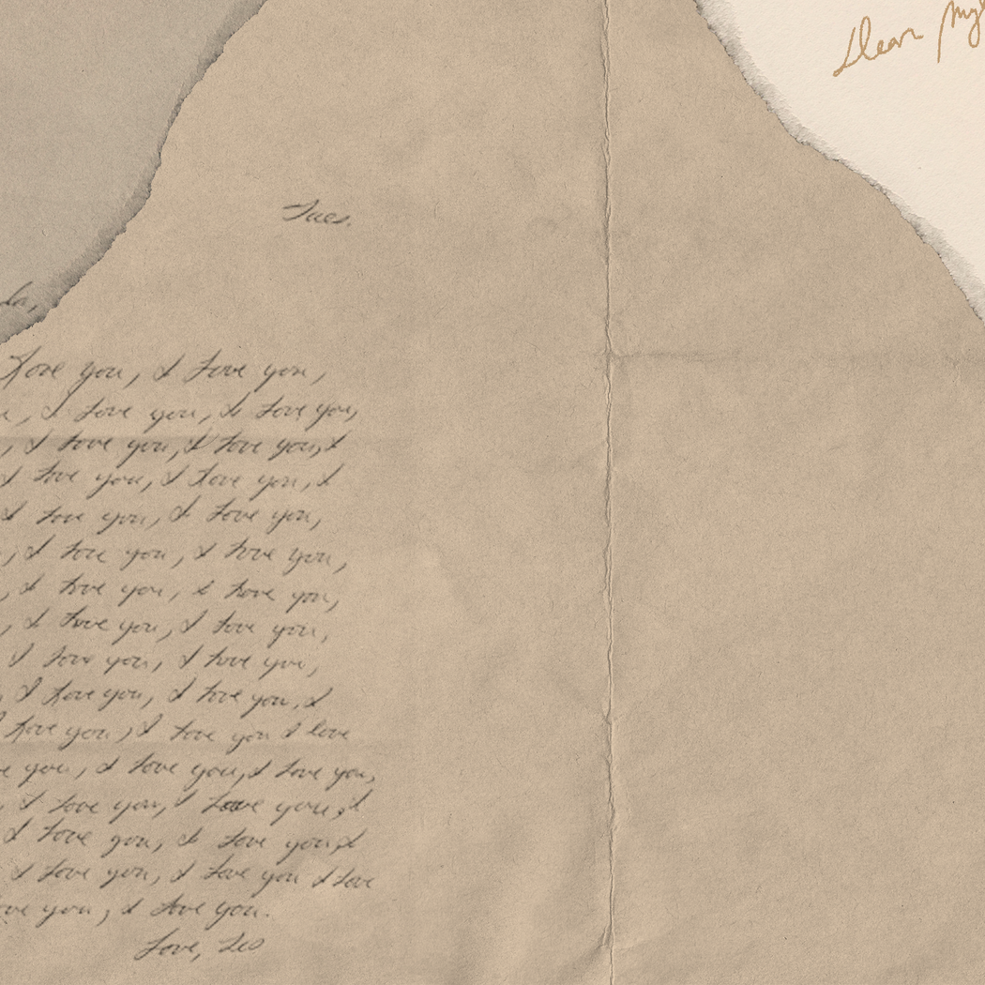

Machine Learning
Imagine a novice geologist, new to rocks
He studies them, looking at field guides, making comparisons until he can identify them on his own
The same thing is done using computers, data (like images or words), and labels that give meaning to data features

Slide 4

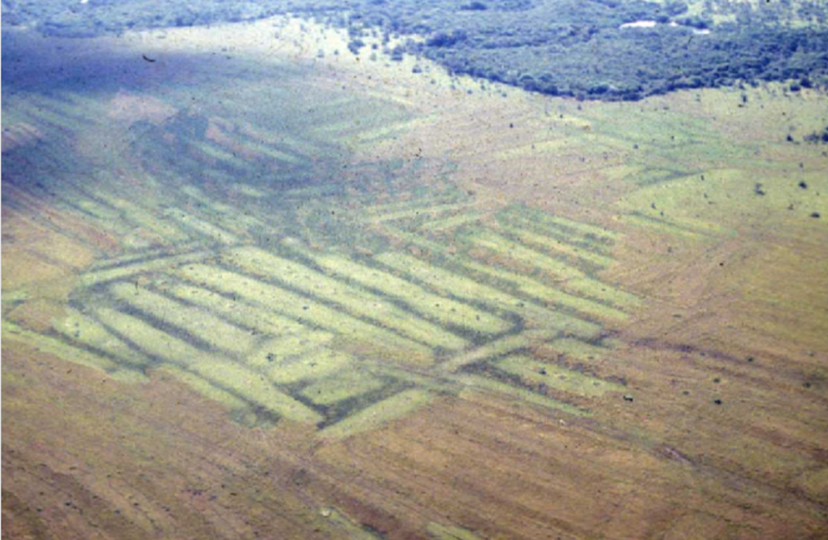
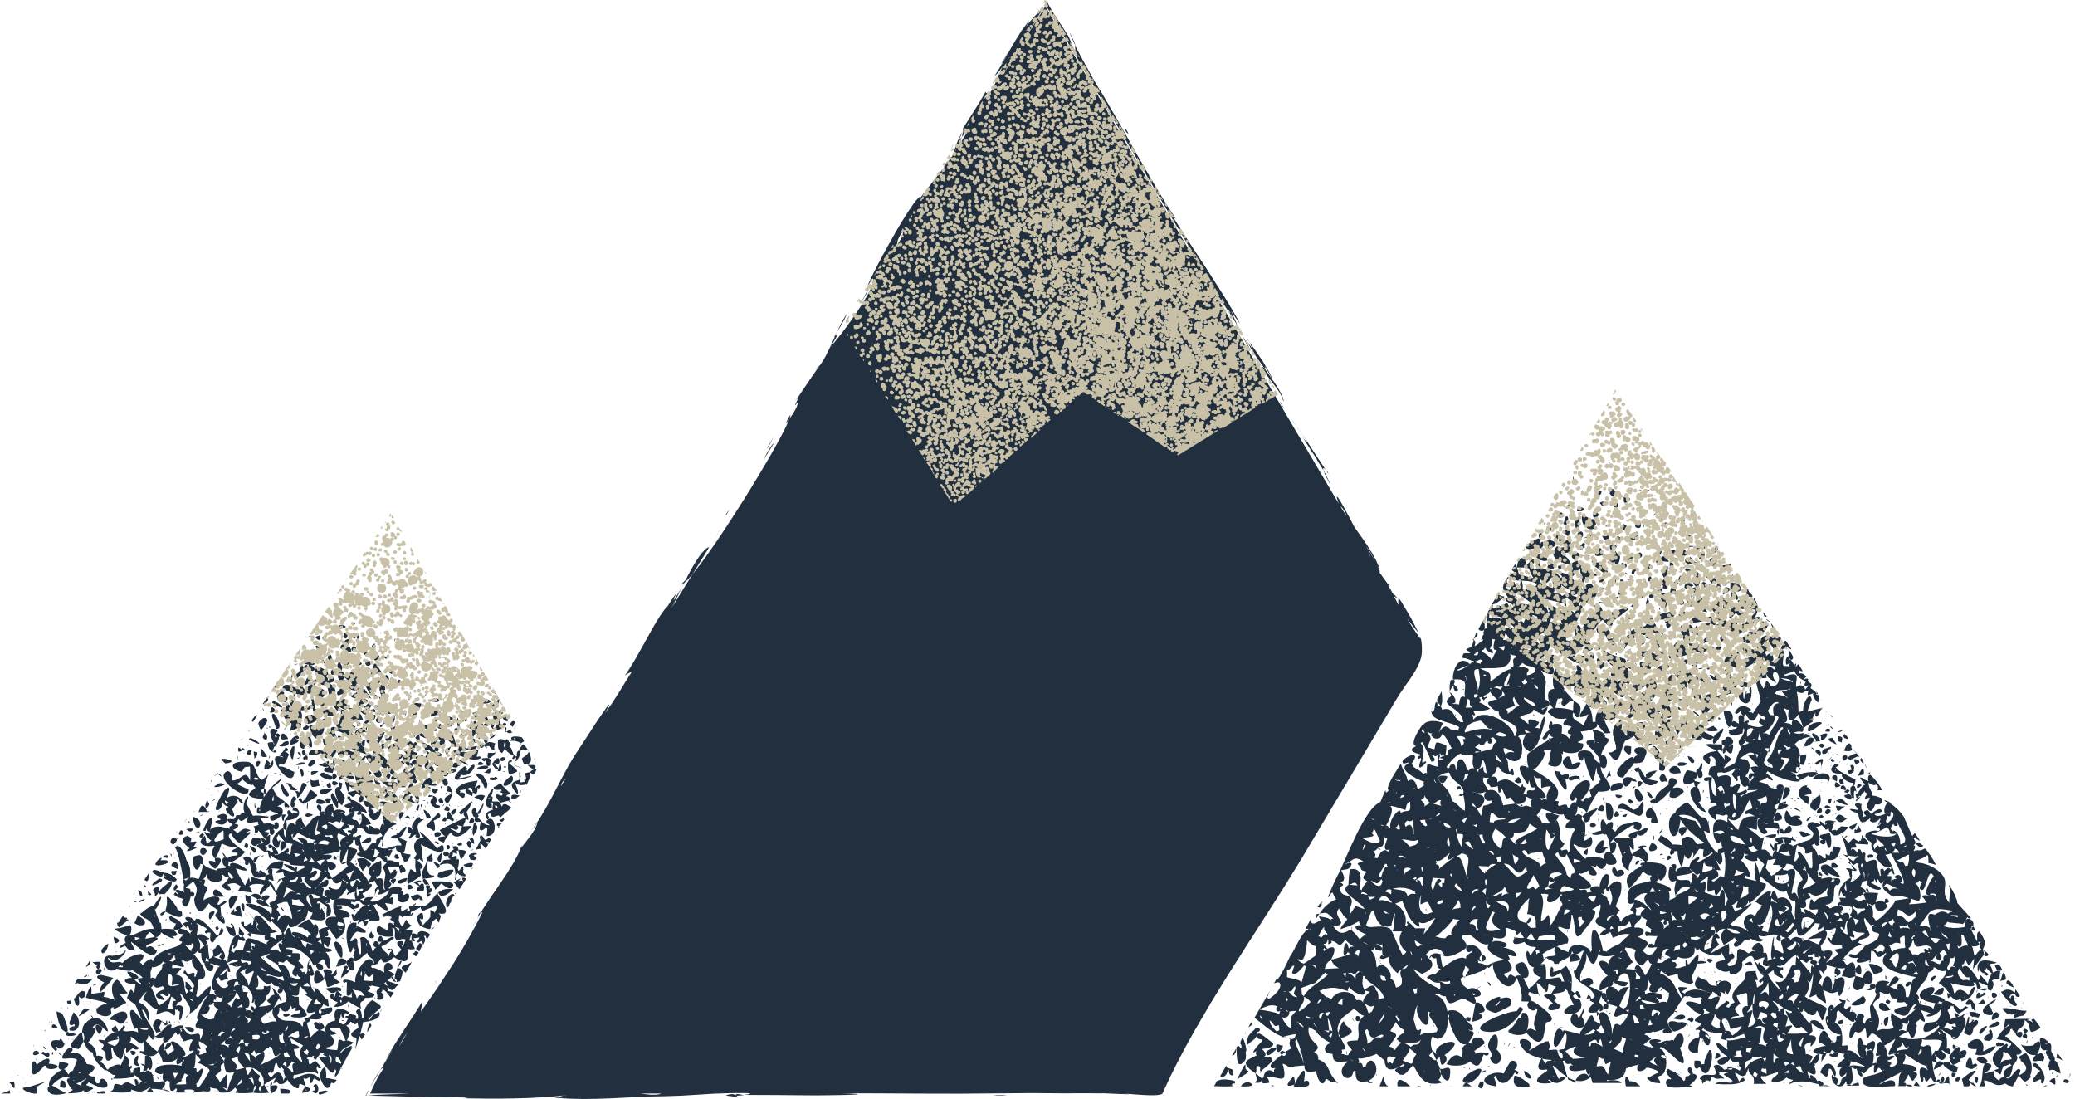
How we Did It
1. Given access to Dr. John Walker’s Raised Field data set on ArcGIS
2. Cleaned and labeled data
3. Edited a Yolov8 Model made by Olivia Zhang to process data
4. Ran it through the new model

Slide 5

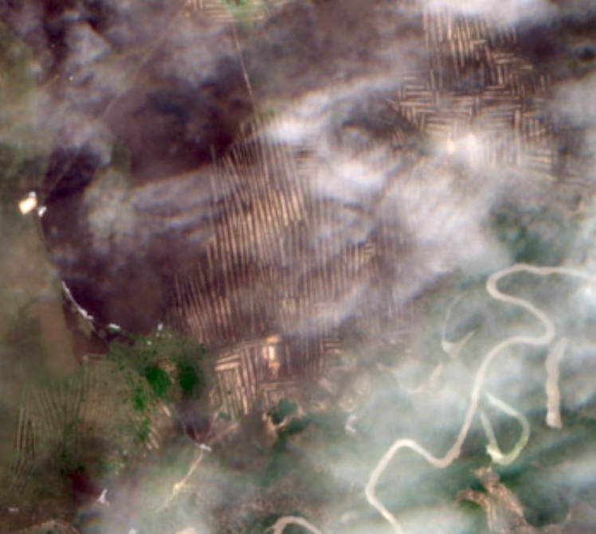
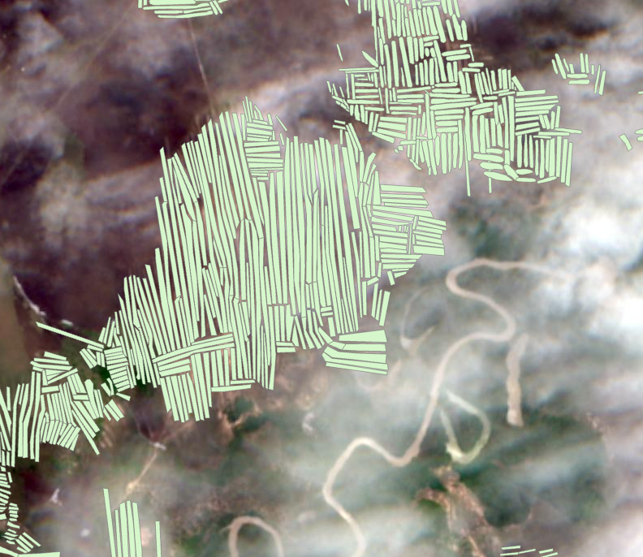
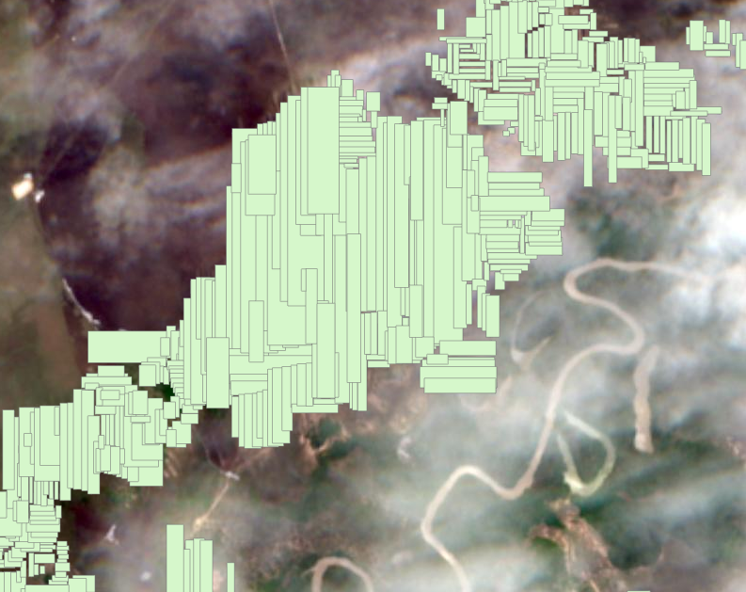

Slide 6
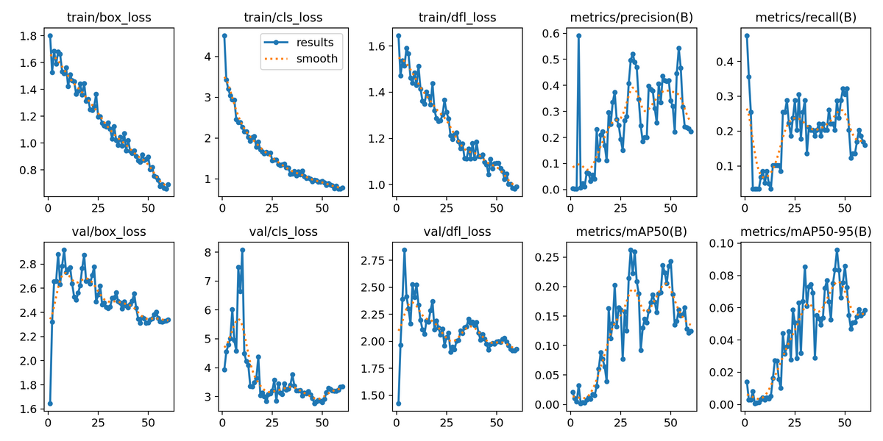
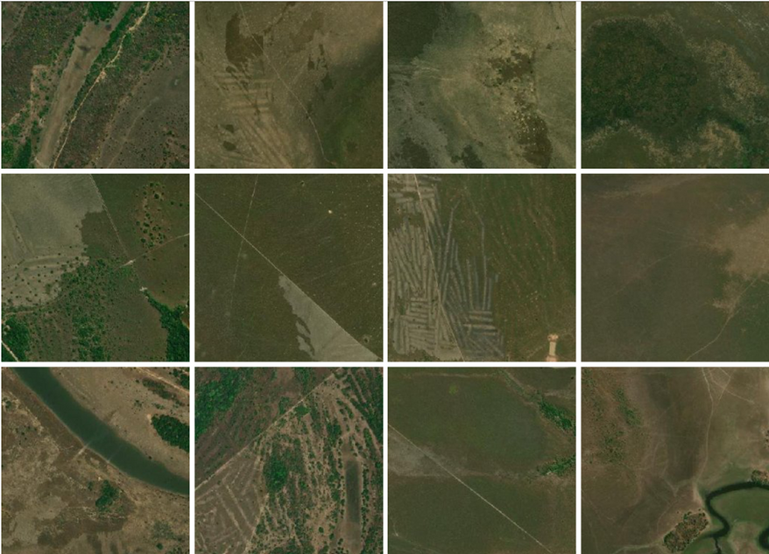

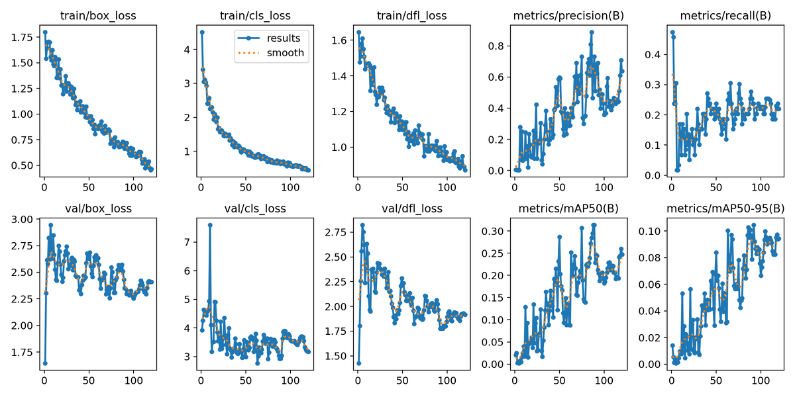
Results
V1
V1
V2

Slide 7
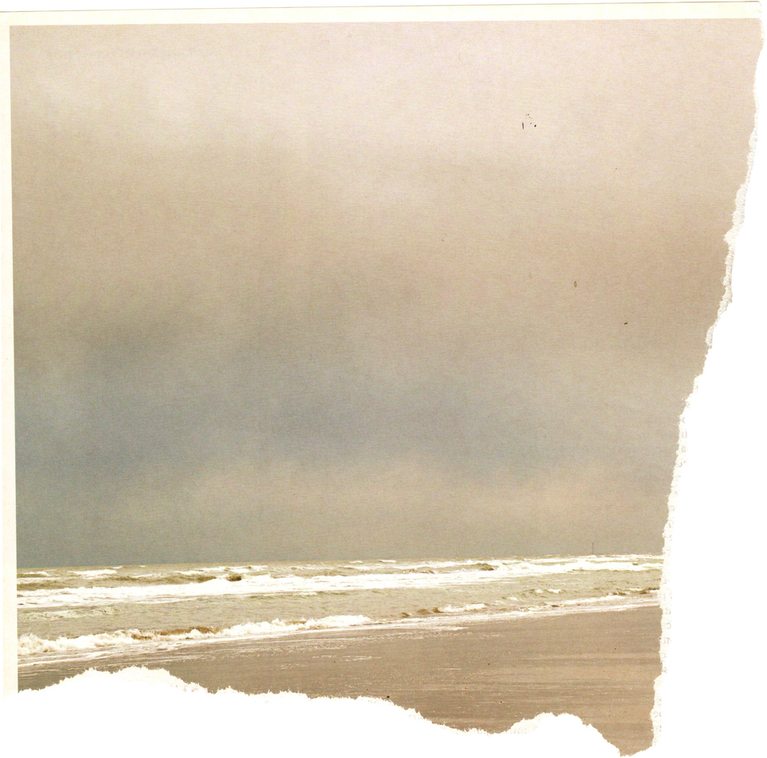

Takeaways & Future Plans
Present research with Olivia @ Florida Undergraduate Research Conference
Apply machine learning and AI to more behavioral and cultural questions using agentic modeling
Excited to continue explorinug this new fronmtier combining AI and Anthropology
Will train models on other structures in Bolivia
Experience working with machine learning models to branmch into computer vision
Foundation for cultural development modelign

Slide 8



Thank you FLMNH
-RR

